Slide 1
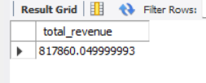
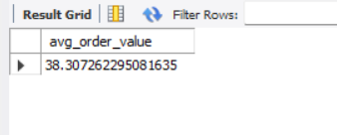


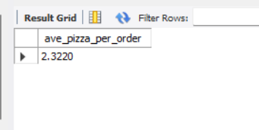
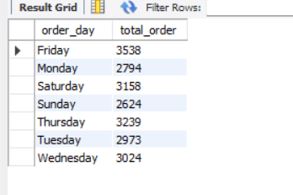
select sum(total_price) as total_revenue from pizza_sales;
2.Avg order value
select (sum(total_price)/count(distinct order_id) ) as avg_order_value from pizza_sales;
3.Total_pizza_sold
select sum(quantity) as total_pizza_sold from pizza_sales;
Total order
select count(distinct(order_id)) as total_order from pizza_sales;
Avg_pizza_per_order
select sum(quantity)/count(distinct order_id) as ave_pizza_per_order from pizza_sales;
Daily trend over total order
SELECT DAYNAME(order_date) AS order_day, COUNT(DISTINCT order_id) AS total_orderFROM pizza_salesGROUP BY DAYNAME(order_date)order by order_day;

Slide 2
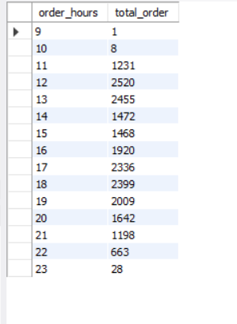
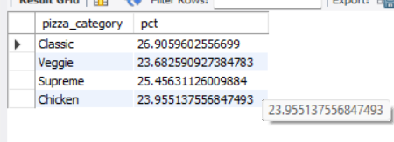
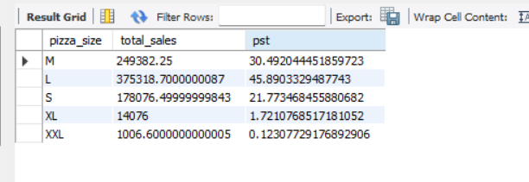
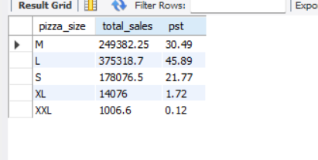
Hourly trend for total orders
select hour(order_time) as order_hours , count(distinct order_id) as total_order from pizza_salesgroup by hour(order_time) ;
Percentage of total sales
select pizza_category , sum(total_price) * 100/ (select sum(total_price) from pizza_sales) as pct from pizza_sales group by pizza_category;
Percentage of total sales by pizza_size
SELECT pizza_size, ROUND(SUM(total_price), 2) AS total_sales, ROUND(SUM(total_price) * 100 / (SELECT SUM(total_price) FROM pizza_sales), 2) AS pstFROM pizza_salesGROUP BY pizza_size;

Slide 3
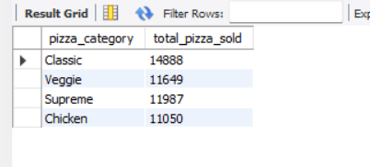
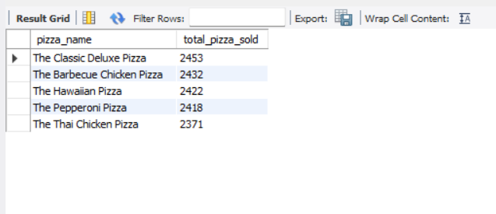
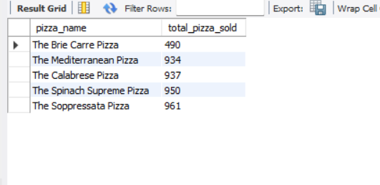
Total_pizza_sold by pizza_category
select pizza_category, sum(quantity) as total_pizza_sold from pizza_salesgroup by pizza_category;
Top 5 best seller by total_pizza_sold
select pizza_name , sum(quantity) as total_pizza_sold from pizza_salesgroup by pizza_nameorder by total_pizza_sold desc limit 5;
Top 5 worst seller by total_pizza_sold
select pizza_name , sum(quantity) as total_pizza_sold from pizza_salesgroup by pizza_nameorder by total_pizza_sold asc limit 5;

